Slide 1



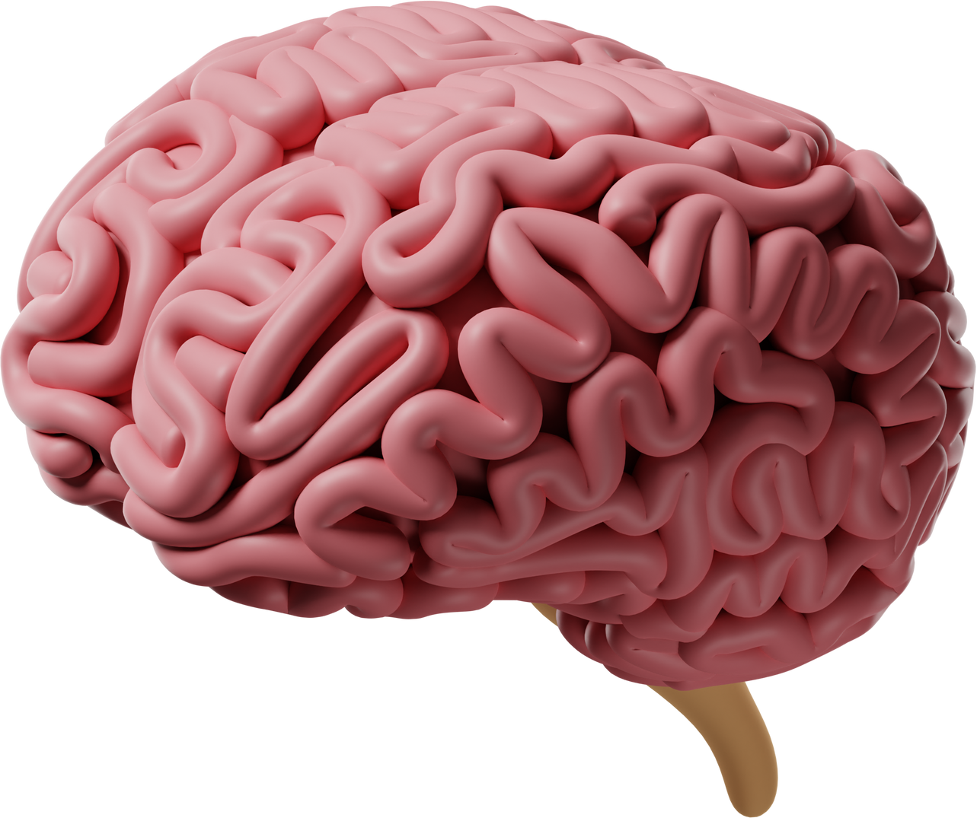
USING BUSINESS INTELLIGENCE TECHNOLOGIES TO IMPROVE DIABETES CARE AND OUTCOMES: A DATA-DRIVEN APPROACH
TEAM MEMBERS-GROUP H8
1. PRANAY YELLAMANDALA
2. VIVEK REDDY
3. ANIL VARIKUPPALA

Slide 2

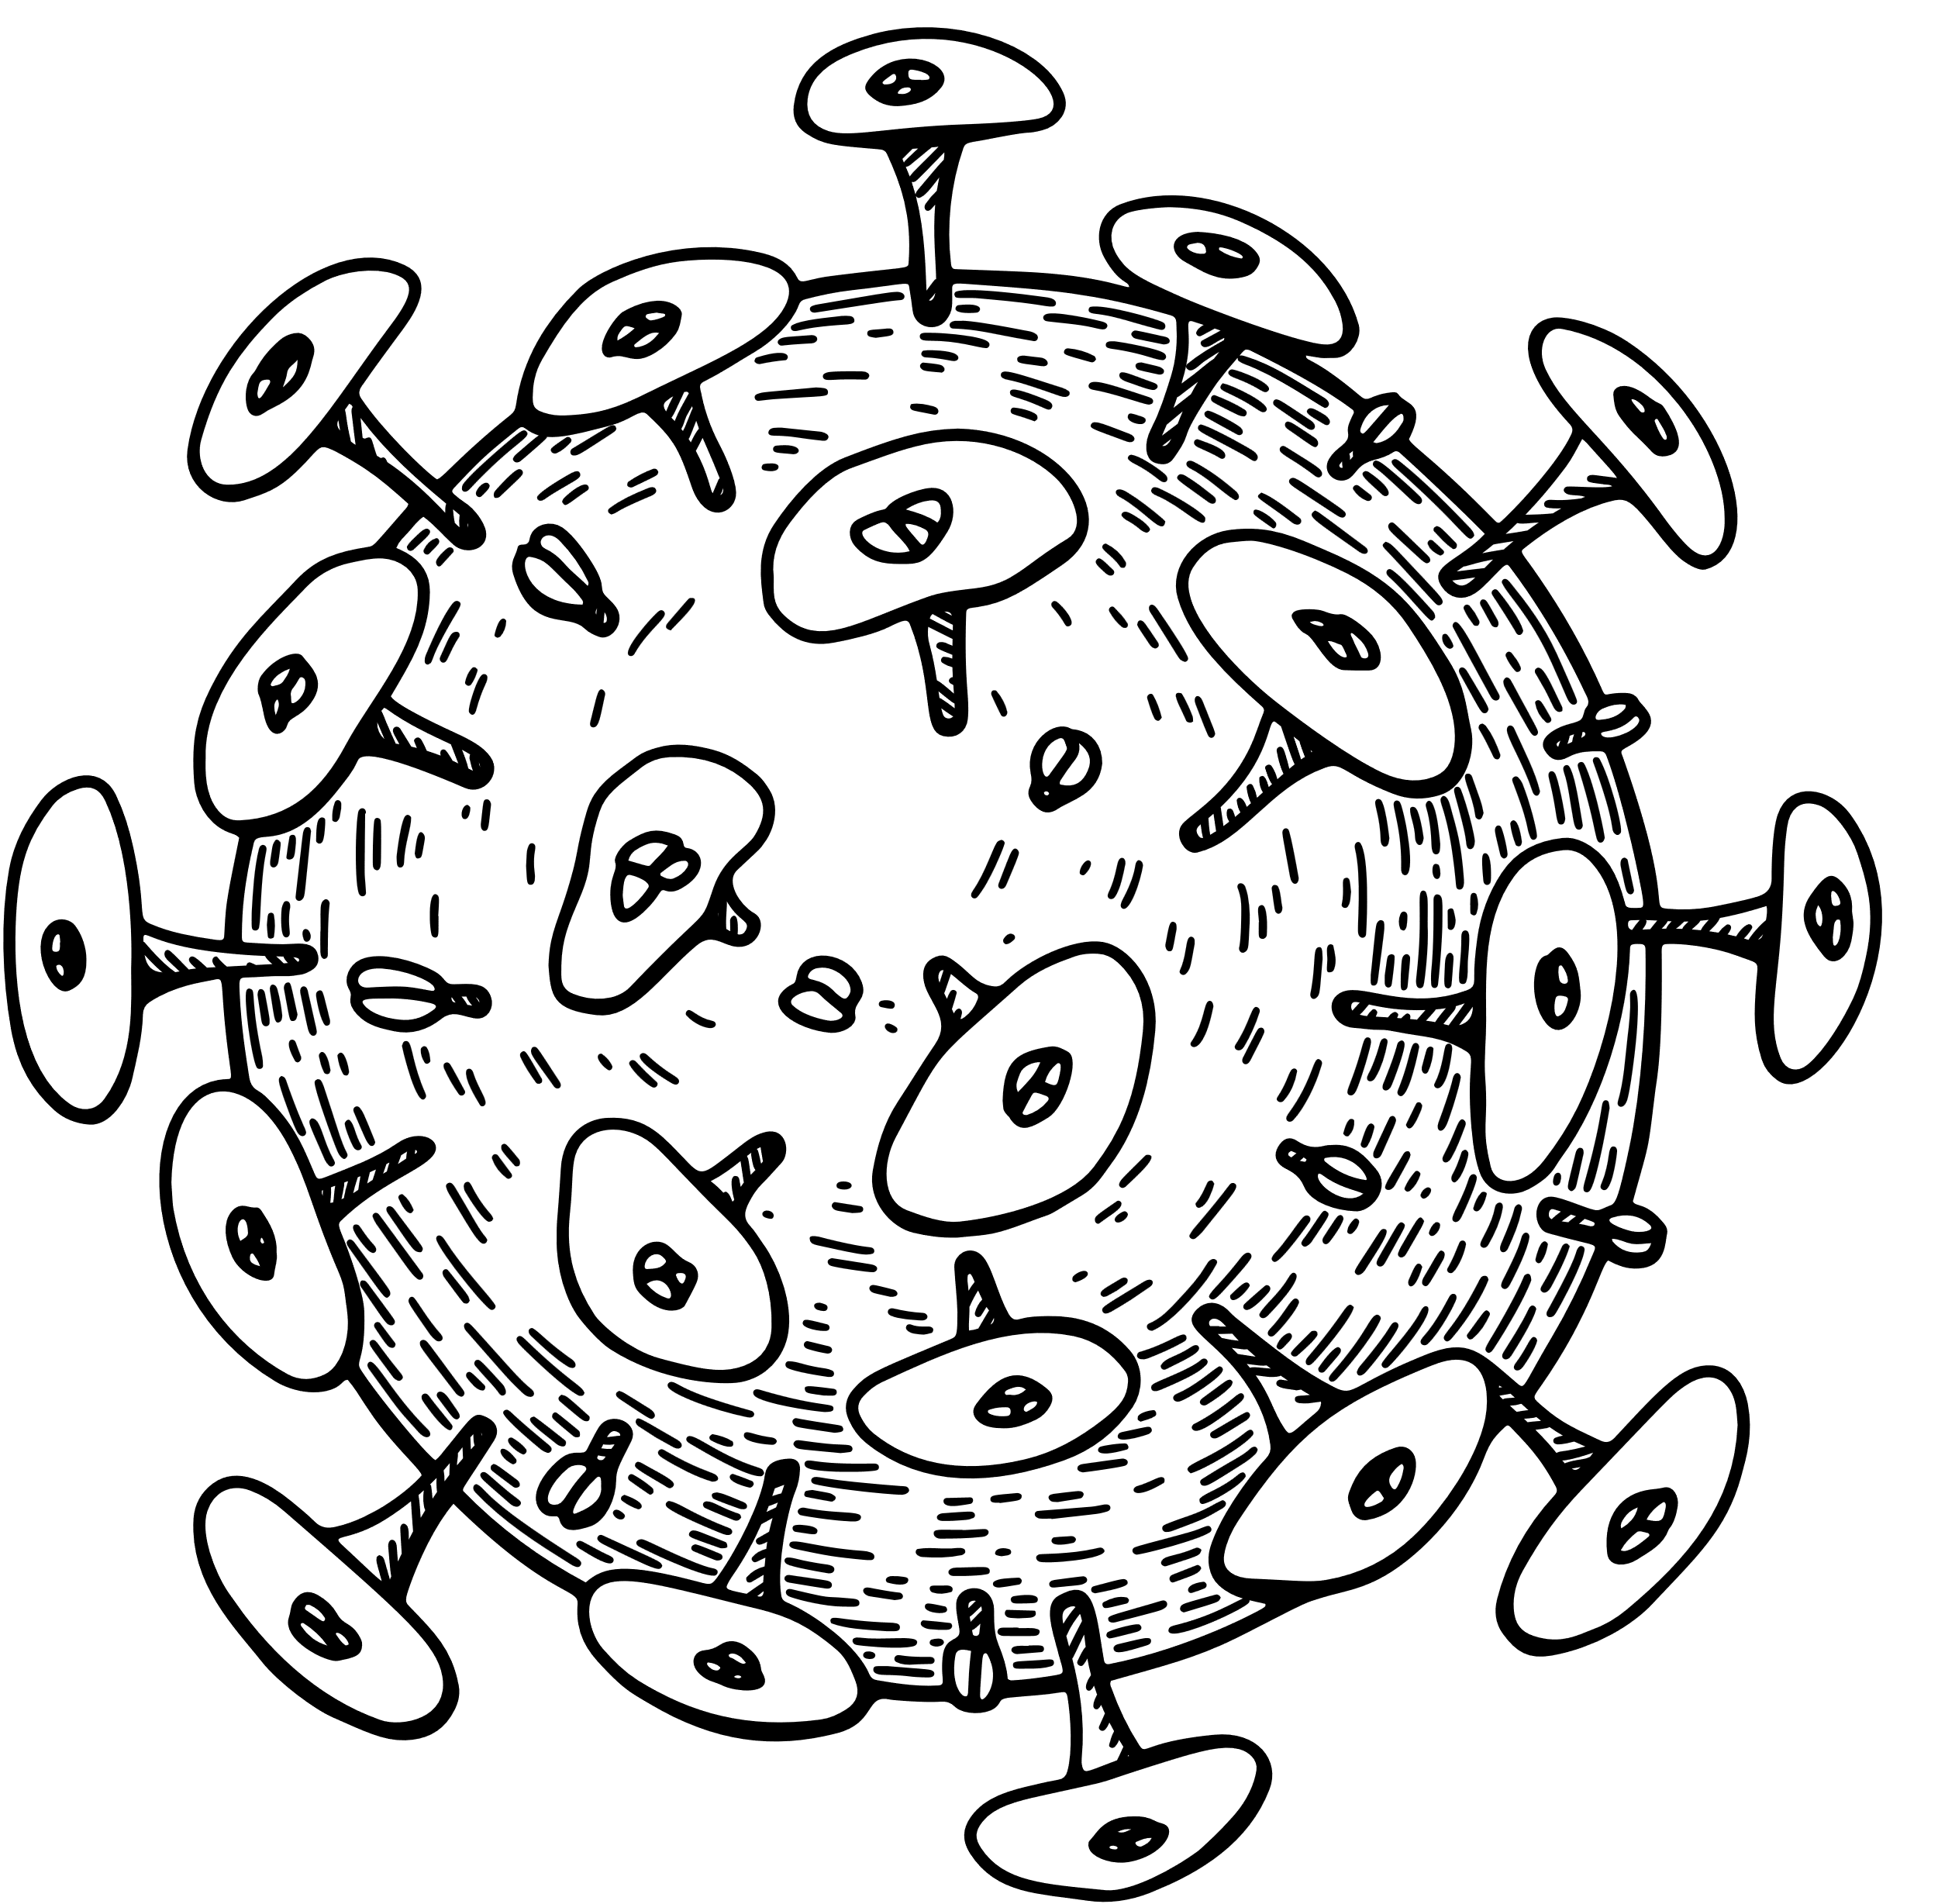

Introduction
Hello everyone, and welcome to our presentation on diabetes informatics management.A chronic health condition known as diabetes affects millions of individuals worldwide. It happens when the body is unable to efficiently use or create enough insulin to control blood glucose levels. Serious consequences from diabetes might include renal failure, nerve damage, eyesight loss, heart disease, and heart disease.
Our initiative uses business intelligence technology to try to solve this issue. The procedure of gathering, analysing, and presenting data to aid in decision-making and problem-solving is known as business intelligence. Our initiative leverages business intelligence technology to improve patient education, expedite diabetes treatment, and aid in decision-making.

Slide 3


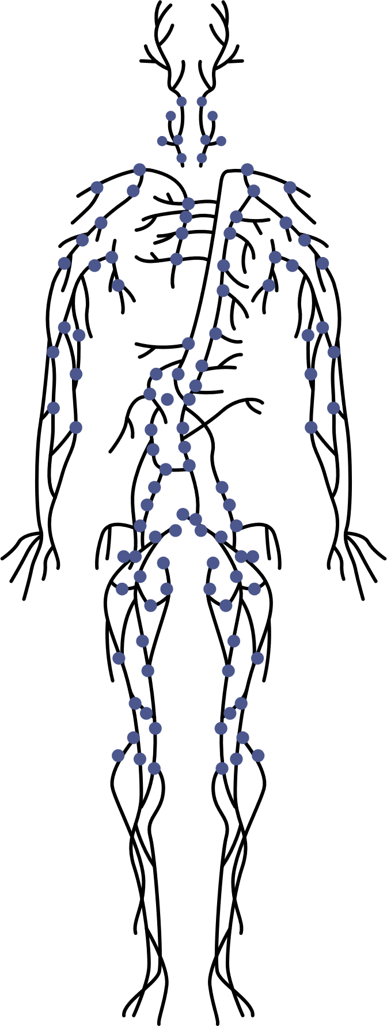

CONTEXT OF THE DATA SET
We will discuss the data set we are using for this project on this slide. The Scikit-learn toolkit, a well-liked Python machine learning tool, provided the data for our analysis. The Strong Heart Study, a lengthy investigation of diabetes mellitus and its consequences in American Indians, served as the foundation for the data collection. The research, which covered 12 American Indian tribes from Arizona, Oklahoma, North and South Dakota, was carried out from 1988 to 1999. Digitalized medical records from 500 research participants with diabetes are included in the data collection.
We utilise certain descriptive statistics and visualisations to summarise and depict our data collection in order to characterise it. The frequency distribution of each variable is displayed using histograms, the outliers and quartiles of each variable are displayed using boxplots, the correlation between two variables is displayed using scatterplots, and the correlation matrix of all the variables is displayed using heatmaps. The proportion of patients with CHD by sex and age group is also displayed using bar charts.
Because it enables us to examine the variables that affect diabetes care and outcomes in a particular demographic group, our data collection is appropriate for our purpose. It offers thorough details about the patient's lifestyle, medical background, blood sugar levels, and medication compliance.

Slide 4





DATA SET
Dataset Overview:
500 entries from Strong Heart Study
Identifies diabetic participants, with 22 clinical traits.
Clinical Variables:
Age, BMI, blood pressure, lipid profiles
Blood sugar control: FPG, HbA1c.
Diabetes Progression & Kidney Health:
PPG, UACR, eGFR, CREA, UA.
Electrolyte Balance:
NA, K, CA, MG, P.
Nutritional Status:
ALB(Albumin)
CHD(Coronary Heart Disease) Presence:
Binary variable for coronary heart disease.
This concise slide provides a snapshot of the dataset's key clinical variables and their
relevance to diabetes and health assessment.

Slide 5


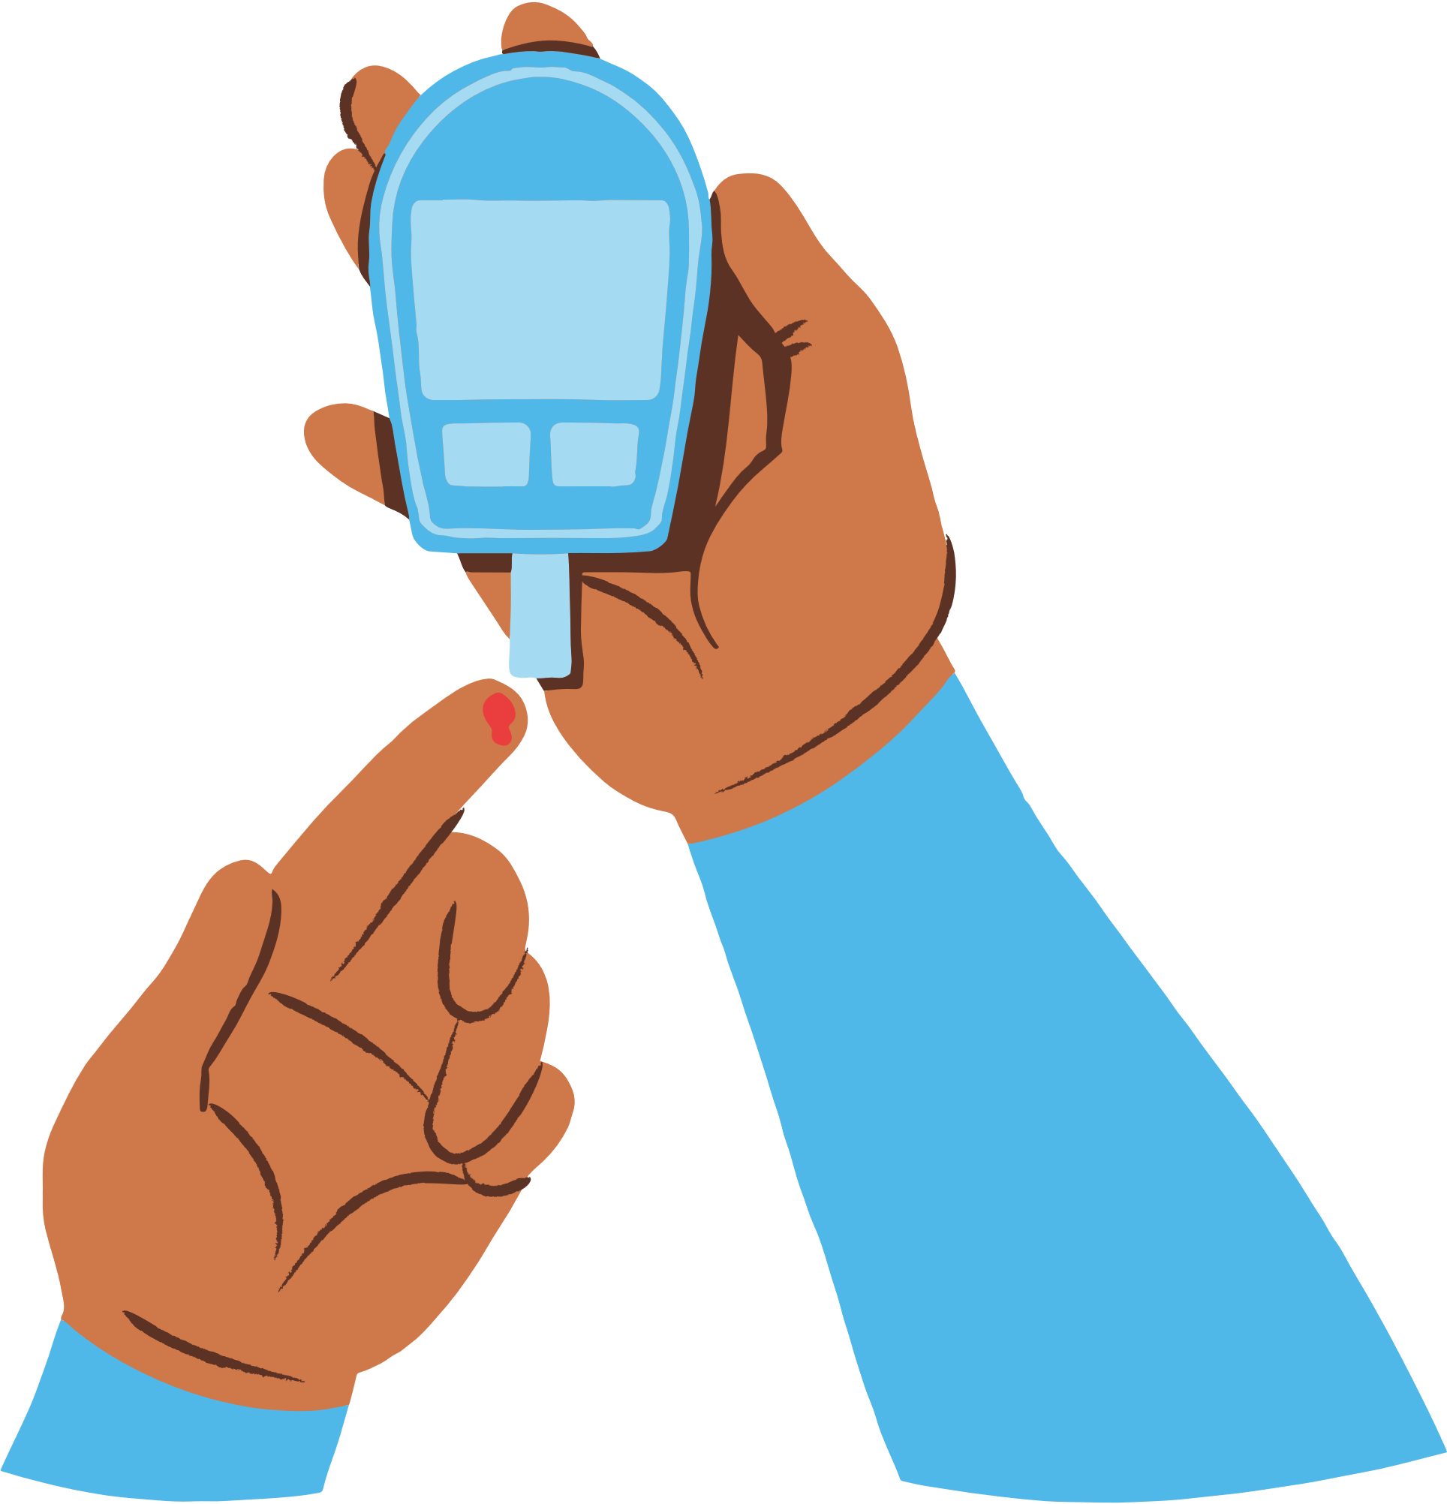
DATA EXTRACTION, CLEANING, AND PROJECT OBJECTIVES IN DATA ANALYSIS
Data Extraction and Cleaning:
Acquired Strong Heart Study dataset.
Ensured data accuracy and reliability.
Addressed missing data and outliers.
Verified data consistency and integrity.
Employed imputation techniques for missing data preservation.
Project Objectives:
Pattern Recognition:
Identify patterns in medical records.
Analyze blood glucose levels, medication adherence, and lifestyle.
Customize diabetes care solutions.
Patient Education:
Empower patients with data-based instructional materials.
This additional information highlights the steps taken to verify data consistency and the use of imputation techniques for preserving data integrity during the cleaning process.

Slide 6


THANK YOU
TO SEE THIS PRESENTATION

